Slide 1
Research & Analytics capabilities overview

Slide 2

Table of contents
General overview on the company and our services
Infomineo presentation
Presentation of our services
Zoom on Business research & Data analytics
Our relationship with The Firm
Collaboration start & Key milestones
Engagement models
Examples of requests/Use cases
Value proposition: Quality & Coverage

Slide 3







Infomineo has grown into the leader of Brainshoring
Infomineo is a data and research outsourcing provider dedicated to supporting global companies in getting access to information that powers their investment decisions and operations. Our global coverage and unique value proposition has allowed us to develop long term relationships with most of the leading global consulting firms and Fortune 500 companies.
Created in 2011 by an ex-BCG and ex-McKinsey consultants, Infomineo combines leading consulting methodologies and data & research techniques.
Infomineo in figures
290 employees, 55% of women Mix of business and technical (engineering, design) backgrounds
200,000+ requests successfully executed
97% of requests rated as meeting or above expectations
17 nationalities, 13 languages spoken natively
5 offices Casablanca, Cairo, Dubai, Barcelona and Mexico
Geographic distribution of our work: 40% Europe, 40% Middle East and Africa, 20% ROW
85% of our business on a retainer basis

Slide 4
Presentation of services

Slide 5




Infomineo offers a diversified suite of services
Business Research
Desk research
Getting insights through free and paid data sources
Getting the right insights to make better decisions
Primary research
Building new data through cold calling
Graphic Design
Presenting messages in a meaningful and beautiful way
Tech enabled research
Using technology to generate data and insights
Business Translation
Translating business content between languages without betraying the original message
Data Analytics
from cleaning the data to visualizing the model leveraging a full range of analytics capabilities

Slide 6

Our Research service combines different approaches and depth levels
Research
Four Levels of Research
Combination of Approaches
Three Types of Support
Demographics, economic analysis, regulatory frameworks, Doing Business, customized country profiles
Open sources and paid sources such as Orbis, Capital IQ and Factiva, MagniTT, etc.
Via phone-based conversations with public and private organizations
Ad-hoc or long assignments
Answering research requests to support project execution, proposal development or internal work
Country
Market sizing, competitive landscaping, sectoral analysis, value chain analysis, market regulations analysis
Market
Strategic watch
Preparing newsletters, regular benchmarking, tracking competitive moves, etc.
Desk research
Primary research
Company financials analysis, company profiling, product /service offering analysis, supplier / client identification
Company
Tech enabled research
Consumption trends and customer reviews analysis for specific products / services
Content development
Databases’ creation, participating in thought leadership
Consumer/ Expert
Social listening, web scraping

Slide 7




Infomineo offers a full suite of Data Analytics Services
Analytics
Three Levels of Analytics
Business Oriented Approach
Three Types of Data Services
Data Exploration
Statistical Analysis
Data Visualization
Brainshoring: business sense and critical thinking applied to our clients’ problems
We work in an iterative approach to be always align to our clients’ needs and expectations
Acquire and Prepare
Unleash the power of Information
Discover, assess, clean, and transform Data from multiple sources with ease
Data
Analysis
Business and Data Understanding
Analyze
Empower your business with dynamic insights with unified Self-Service Analytics;
Tackle critical business challenges using cutting-edge models
Model building and tuning
Model evaluation and retraining
Agile Methodology
Data
Science
Delivery Management
Data Sourcing and Integration
Data Cleaning
Feature Engineering and Data transformation
Model Deployment and scalability
Data Engineering
We take care of release and change management, including versioning, unit tests, model validation, documentation, etc.
Deploy
Bringing Models to Life
Seamless deployment, monitoring, and integration into client's infrastructure for maximum impact

Slide 8
Our Data Analytics service can handle all steps of a Use Case
Analytics
ACQUIRE and PREPARE
ANALYZE
DEPLOY
Data Sources
Integration
Storage
Preparation
Exploration
Visualization
Modeling
Delivery
ERP
Batch Data Integration
Warehousing
Environment
Data Quality
Statistics
Prescriptive Analytics
Recommendation Systems
Model Monitoring
Predictive Analytics
Time series
DS/ML Platforms
CRM
Stream Ingestion Real time
NOSQL Environment
Data Cleaning
Feature Engineering
Simulation and Optimization
Segmentation
Version Control
Databases
Message Broker
Big Data/Distributed Environment
Data Transformation
Reports
Speech Analytics
Machine Learning
Orchestration
Video/Image Analytics
Security
External Sources
Cloud
Environment
Dashboard
Deep Learning
Graph Analytics
Text Analytics
Containerization
Files
Real time Reporting
Geospatial and
Location Analytics
Sentiment/ Behavior Analytics
Interfacing

Slide 9
Our support to McKinsey teams

Slide 10
















Infomineo and McKinsey started their collaboration in 2013 and today our McK-dedicated research team size is almost 10x larger with a global coverage
Infomineo starts a retainer with McK.
3 FTEs supporting the Casablanca, Paris, Johannesburg offices
Very high staffing levels (85-90%) which trigger regular capacity increases to properly absorb the demand from McK teams
Setting up a Healthcare-specific research team
5 FTEs
7FTEs
9 FTEs
10 FTEs
11 FTEs
14 FTEs
19 FTEs
27 FTEs
34 FTEs
2013
2014
2015
2016
2017
2018
2019
2020
2021
2022
2023
Provision of Sunday coverage with the opening of Infomineo’s Cairo office to better support MEO teams
In February 2022, we opened our Mexico office to better support McK offices in the Americas
Evolution of the number of offices we work with (not exhaustive)

Slide 11

The engagement models
Ad hoc requests support
Dedicated support
For which need ?
Long research projects
Building out sector-specific teams
Short requests
How does it work ?
You send us the request details with context, scope of work, DL, format and the charge code
You send us an email explaining the need or capacity reservation request. A call is planned to clarify the scope and needs (# of analysts to be staffed, #days of support, languages and seniority requirements)
How to reach out ?
mckinsey@infomineo.com
Research: mckinsey@infomineo.com
A dedicated email can be created (e.g., Mck_hc@infomineo.com for the McK Healthcare team)
Copyright © 2023. All rights reserved.
Main users
Local and regional C&I teams
Practice-affiliated research teams
Project teams
Notes: 1/ Our Master Service Agreement with the Firm includes clauses related to confidentiality. 2/ For research requests, someone from the McK C&I or Knowledge network needs to be in the loop.

Slide 12
Examples of requests / Use cases

Slide 13


We support the local & regional C&I teams mostly to answer open-ended questions to better understand specific markets and industries
Research
Type
Topic
Request
Office
Approach
Market analysis
Facility Management services for hospitals
We are interested in understanding:
The contracts for Facility Management activities (both hard and soft),
Their end date/renovation date for each of the hospitals and
(If possible) the player who is handling it
1. Breaking down the need into specific points
Provision of a list of hospitals with the largest bed capacity for selected regions (Veneto, Lombardy, Emilia Romagna, etc.)
Identification of the operator in charge of providing facility management services for each h²ospital along with the information on the concession end date
2. Clarifying the ask to mitigate risk of misalignment
Specifying with the client the types of FM services to focus on (Hard= hard maintenance, EN management), Soft=Cleaning)
3. Defining a targeted research strategy deploying different research methodologies
Secondary research: Istat – Health statistics; ISS (Istituto Superiore di Sanita), hospital’s website + Press search, Public tender documents
Primary research was also leveraged to confirm the FM operators
Market regulation analysis
Information security and data regulation for the banking sector in Egypt
We are building a perspective on the Central bank of Egypt’s regulations about data usage and information security.
We are looking for a view on:
Data Regulations for banks in Egypt
Guidelines and requirements that banks should follow to use data
Information security framework to be followed by banks and financial institutions
1. Clarifying the objective of the research
Underlying question is: How can banks use and monetize the data they have ?
2. Mapping the regulations by the CBE around the use of customer data
Protection of Banks’ customer data, Clients rights protection law)
3. Getting the perspective on regulations regarding customer data usage within the telco sector
How ?
For the above, secondary research has been conducted leveraging the relevant authorities' websites (CBE, Financial Regulatory Authority, National Telecommunications Regulation Authority)

Slide 14



Different practice areas are also leveraging our teams for industry-specific research and market analysis (1/2)
Research
Practice
Main topics covered
Offices we work with
Examples of Use cases
Level of depth provided
SHAPE
Education
Healthcare
Social sector (NGOs)
Benchmark of public policy schools' governance
In-depth analysis of healthcare compensation for physicians in KSA
Insights on how school leadership is appointed, what are the governance and organizational structures of each school, backgrounds of the board’s members
Different perspectives provided with the sector-level information, salaries of resident doctors provided by the Ministry and compensation package shared by specific hospitals for different positions / seniorities
PFIC
Banking
Insurance
Neo-Banking
Mapping of mortgage advisory platforms in Spain
Case studies of banks in Africa leveraging product and service to achieve SDGs
Selection of the platforms based on specific criteria (digital advisory and loan origination journey integrated). The annual web traffic and details on services offered were provided
8 banks covered including information on the type of offering, the SDG addressed and impact elements. The scope has been extended to SMEs as well.
EPNG
Utilities
O&G
Renewable Energies
Showing that power utilities in Africa are not financially viable through specific metrics
Market analysis of the jet fuel market in France
Profit / Loss data provided for 22 countries including Capex and Opex information whenever possible
View on the jet fuel distributors (Total Energies, Shell, AirBP, etc.) and their market shares; supply of jet fuel by airport

Slide 15


Different practice areas are also leveraging our teams for industry-specific research and market analysis (2/2)
Research
Practice
Main topics covered
Offices we work with
Examples of Use cases
Level of depth provided
TLI
Transportation
Logistics / Supply chain
Understanding the recent developments in the TLI industry and notably problems related to limited MRO services
Perspective on strategic topics discussed by the management of a certain company (SSA Marine)
Examples of airlines facing flight cancellation due to MRO-related issues with a view on how the communication was formulated to customers, sizing of the demand for MRO and forecast (2029, 2032) and identification of factors affecting air travel
Through an exhaustive press search, strategic topics found are around digitization, sustainability, Operations issues, Labor issues , M&A transactions
ECB
Construction
Engineering
Building Materials
Identifying construction companies working in seaport facilities in the US Virgin Island region
Identification of seaport projects in the specified region and providing the names of the EPC involved in those projects
Sustain-ability
ESG & Net-zero strategy
xxx
Understanding reasons for failure of Kvaerner’s carbon black production facility
Understand instances of negative journalism for 5 carbon offset standards
Information and case studies on the reasons for failure highlighting problems around mechanical components, quality control issues, etc.
Identifying articles criticizing the specific carbon offset standards with a global perspective (examples of countries for which examples were found include Cambodia, Colombia, Madagascar)

Slide 16









A Comprehensive Dashboard of Key HR Metrics and Performance Indicators
Client Challenge
Our Solution
Outcome
The client wanted to have an automated Human Resource Dashboard to track, analyze and report on HR KPIs.
The firm was looking for:
The company decided to use Infomineo’ Data Analytics service as a solution to cover:
The client benefited from Infomineo Data Analytics service on multiple fronts:
Stable and Reliable Data:
Correction & Standardization of ERP data, eliminating manual file usage
Significant enhancement in accuracy +75% for Critical Data Elements
Organizational Efficiency: 1 HR FTE reallocated to other tasks due to streamlined data processes.
Companywide Transformation: The client embarked on a data transformation journey, partnering with Infomineo to create alsol financial dashboards
Data Quality & Consistency problems between the various Data sources
Effective and quick solution
Dashboard creation reflecting the HR Team’s needs
Smooth integration with its existing ERPs
Ad-hoc deliverables: Dictionaries, Creation of Metadata, Data Quality Process
Lower cost than subscribing to a dedicated HR Dashboard tool

Slide 17

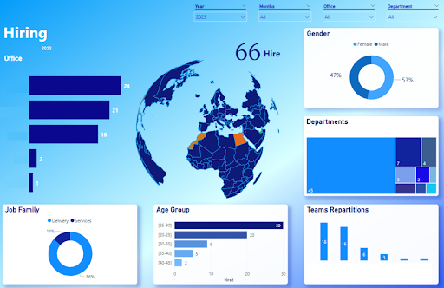

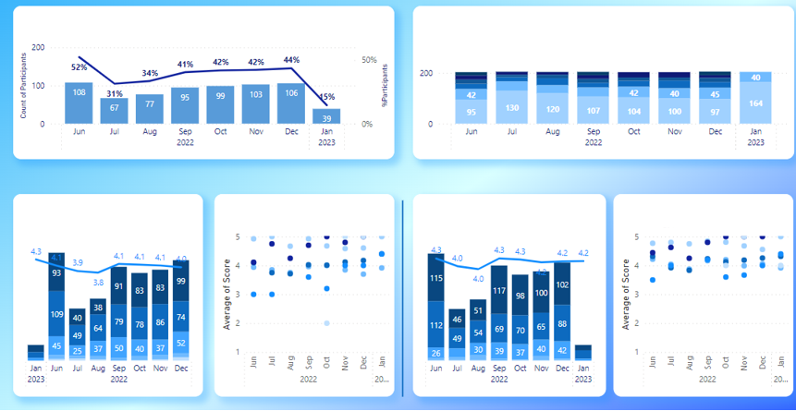
A Comprehensive Dashboard of HR Key Metrics and Performance Indicators
Achievements
Elaborated Data Model: Gathering and transforming data from 5 different tools
Automated Source Reports: Created 14 source reports and automated their extractions using APIs, ensuring efficient and timely data retrieval.
Automated Data Quality Checks: Implemented automated data quality checks based on predefined business rules, ensuring data integrity and accuracy.
Extensive Dashboards: Delivered a comprehensive report comprising 30 dashboards, featuring +150 graphs, and including +50 KPIs.

Slide 18

Web Scraping Tool for Second-Hand Car Sales
Client Challenge
Our Solution
Outcome
To analyze the secondhand automobile market in Morocco the client needed access to relevant and accurate data.
The client chose to use data of the country’s leading C2C e-commerce platform.
The firm was looking for:
Infomineo’ s Data Analytics team addressed the client’s challenges by developing :
The client benefited from Infomineo Data Analytics service on multiple fronts:
Comprehensive Web Scraping Tool
The client received a user-friendly web scraping tool equipped with a user interface, enabling tailored requesting.
Expanded Data Extraction Capabilities
Datasets were created from the e-commerce platform across various cities and categories, enhancing data extraction capabilities.
Time and Resource Savings
The client achieved significant time efficiency in the data collection process, resulting in resource savings.
Comprehensive Data Collection Strategy
Establishing a robust data collection framework and implementing efficient methodologies to gather the required data.
User-Centric Interface Design
Crafting a user-friendly graphical user interface (GUI) that simplified the data collection process for the client
Data Quality Assurance
Implementing rigorous cleaning and preprocessing techniques to ensure the integrity and reliability of the collected data.
An efficient and consistent way to regularly collect data from an e-commerce website
Create a database with the data collected daily to avoid bias of unsold items

Slide 19

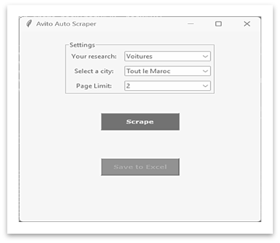
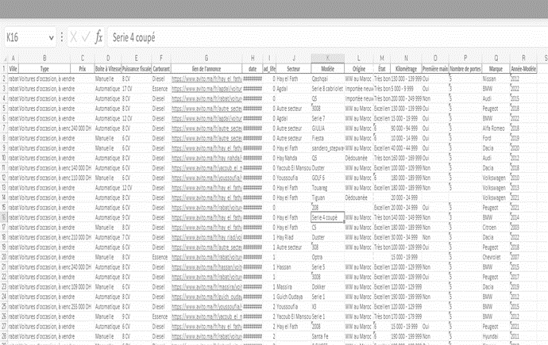
Web Scraping Tool for Second-Hand Car Sales
Streamlined Data Collection Methodology
Establishing Data Collection Requirements
Identification and selection of +15 core data elements crucial for analysis, enabling the client to perform comprehensive insights generation.
Developing a Data Collection Plan and Storage
Implementation of a daily automated process to pull car listings from across the country, creating an up-to-date database for analysis purposes.
Designing a graphical user interface (GUI)
Development of a user-friendly GUI that allows the client to effortlessly select specific car brands/models and collect data on demand.
Cleaning and preprocessing the data
Built of robust cleaning and preprocessing techniques to enhance data quality and usability, including removing duplicates, correcting inconsistencies, and standardizing data formats.

Slide 20
Geospatial Analysis of Labor Catchment: Assessing Employment and Demographic Patterns
Client Challenge
Our Solution
Outcome
The client needed to identify optimal locations for unemployment centers and accurately assessing the population in need and its characteristics.
The firm was looking for :
Infomineo’ s Data Analytics team addressed the client’s need by:
Indicator Identification
Selecting relevant criteria such as population statistics, socio-economic factors, and geographic boundaries.
Modelling
Calculation of the percentage area of each municipality within designated buffer zones based geographic coordinates.
Development of an algorithm that accounted for a homogeneous distribution of the population.
Geocoding & Visualization
Use of geocoding techniques to transform location data into precise geographical coordinates.
The client benefited from Infomineo Data Analytics service on multiple fronts:
Comprehensive KPI Insights
Delivered a report with averaged KPIs for each buffer zone (e.g., unemployment, educational background, and wages).
Seamless Data Exploration
Developed a user-friendly graphical interface that enables customized analyses.
Scalable Expansion Potential
The graphical interface could be expanded to cover additional European countries for future analysis.
Identifying the most relevant indicators and reliable data sources that will provide them with comprehensive insights.
Calculating the percentage area of each municipality and the estimated population within designated buffer zones based on specific geographic coordinates.
Visualizing the collected data into a geospatial to identify patterns, hotspot areas with higher needs, and make data-driven decisions regarding the optimal placement of our unemployment centers

Slide 21

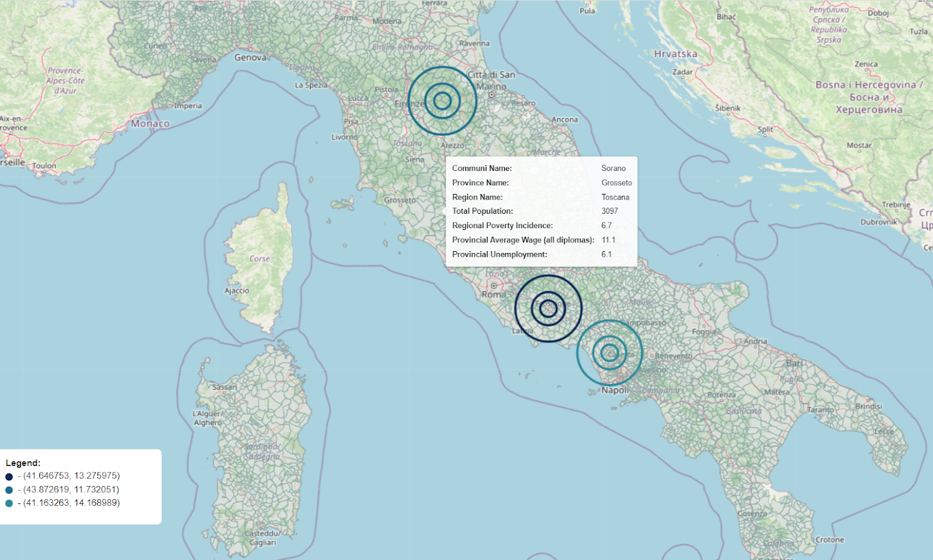
Geospatial Analysis of Labor Catchment: Assessing Employment and Demographic Patterns
Infomineo Approach
Extensive municipal data acquisition: Gather comprehensive data on municipality boundaries and population statistics.
Relevant Data Compilation: Compile additional data on unemployment rates, poverty levels, education background, and regional wages.
User-Friendly Interface: Develop a user-friendly interface for easy excel report requests and uploads. Users can efficiently extract relevant data by inputting specific locations or batches of coordinates for buffer zones.
Interactive Mapping: Create an interactive map that provides a visually immersive exploration of the collected data.

Slide 22
Our portfolio of databases

Slide 23

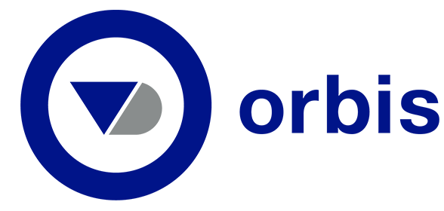






Infomineo gives you access to the main premium databases¹
Database encompassing financial news, market insights, company performance data, and sector-specific data
Information on over 400 million companies and entities worldwide, including financials on over 41 mn of them
Global news database covering over 33,000 sources globally, including premium and sectorial press. Allows for Boolean and advanced research
Aggregator for industrial studies, market and consumer statistics on 60,000 global topics from over 22,500 sources
Use cases:
List of companies based on criteria: location, industry, size, etc.
List of M&A transactions in a specific industry
Qualitative and quantitative information on companies
Automated excel watchlist based on proprietary formulas
Use cases:
Screening of companies based on criteria: location, industry, size, etc.
Qualitative and quantitative information on companies
Identification of top companies in a sector
Long list of PE owned companies in a given geography
Use cases:
Weekly newsletter on a specific topic
Alerts on companies and industries
Press sentiment analysis
Complementary historical news and development from a market player
Market trends from specialized and premium sources
Use cases:
Screening available statistics on a given business topic or country economy
Consumer trends and survey results
Digital market outlook and forecasts
Retail historical indicators and trends
Investments and funding information, founding members and leadership, M&A, news, and industry trends from early-stage startups to Fortune 500
Database of information regarding projects, companies and contacts in the construction and infrastructure field
Investments and funding information about startups in emerging markets (Middle East, Africa, Pakistan and Turkey)
Use cases:
Total amount raised in a country by funding rounds
M&A trends in a high-technology industry
Funding trends and flows by industry and country
Investors attractiveness overview
Use cases:
List of projects in specific industries with their projects value and main stakeholders
Analyst reports on public companies
Report on market data and prices
Use cases:
Topmost funded startups in the MENA region ? Their locations, sub-sectors they operate in ?
Identifying the sectors with the highest level of investment
Who are the international investors that are support the Saudi startups ?
Use cases: The platform provides news articles and analyses on the below topics with an international coverage
Business & Economics
Politics
Technology
Culture

Slide 24
Feedback from the McK teams

Slide 25
Over the past 3 years, +95% of the client feedback on the quality of the dedicated-team’s support is rated either as Excellent or Good
Selection of client feedback quotes
“Thank you so much for your help! The output looks perfect and will be very valuable for the overall insights we are working on." Christina Wallgren - UK
“It was outstanding that Federica made direct calls to the relevant entities in Jordan/Lebanon regarding gold taxation, this was great as it helped us get some missing data points. I look forward to continued thought partnership with your analysts while they support on the tasks” Mohammed Abo Taleb – KSA
Results of the satisfaction survey (2020-2022)
The dimensions assessed are the following: Quality/ Resourcefulness / Insight; Timeliness and Communication / Interaction
“Firstly, thanks a lot for all the great help and support your team has given, especially this year. I really appreciate that I can rely on the team, to get us through some very tricky days. A huge thank you to each one of you, here!! !”, Poonam Bhandarkar – EPNG India
83%
“Very satisfied! The team was extremely fast in output delivery and the data was very helpful“, Marysia Skrzypulec – Poland
Excellent
84%
85%
15%
Good
14%
“Great experience - was my first time working with Infomineo and was super”, Matthew Lamontagne – Boston, USA
“Reactive and effective support, fully addressing needs in a cost-(time-)effective approach”, Alain Imbert – France
14%
2%
Average
3%
1%
“I really want to stress how good Mohamed’s work was - He found something that I probably wouldn’t have been able to find. Really deep research, attention to detail, and creative in finding proxies; in a very short amount of time”, Ahmed Fjer – Morocco
“Thank you so much for this work, again. Above expectations again.” Miguel Sousa Morais – Portugal
0%
Poor
0%
0%
252
259
191
2020
2021
2022
“Thank you, Omar! This is great! And thanks for pointing out the proximity score bias.” Ahmed Sallam – Egypt
Number of responses received
2020
2021
2022
Notes: The client satisfaction survey is shared with the requestor at the end of each request. For 2021, the response rate was between 12 to 14%.

Slide 26
Our office locations and contact details

Slide 27
We provide the Firm with Research support with a global coverage from three main research hubs
Infomineo offers:
17 hours coverage
6 days a week: Sunday to Friday working week
6 native languages: English, Spanish, French, Arabic, Portuguese, Italian
Casablanca
Week: Mon-Fri
04:00 AM – 14:00 PM ET
Languages: En-Fr-Ar-Pt-Sp-It
Mexico City
Week: Mon-Fri
11:00 AM – 19:00 PM ET
Languages: En-Sp-Pt-Ar
Cairo
Week: Sun-Thu
02:00 AM – 11:00 AM ET
Languages: En-Ar-Fr
Legend
Research hub
Native language research coverage
Research coverage in English

Slide 28


Working with Infomineo….
For Research support, feel free to reach out through our McK-dedicated email address
mckinsey@infomineo.com
Fatou Ndiaye
Sr Research Manager –
McK-dedicated team
Client relationship, content development
Taha Akhanchouf
Research Manager –
McK dedicated team
Staffing management
fatou.ndiaye@infomineo.com
taha.akhanchouf@infomineo.com

Slide 29


Working with Infomineo….
For Data Analytics support, feel free to reach out to…
Hadia Ibnabdeljalil
Head of Data Analytics Services
Hamza Laraichi
Primary-contact for contract discussions with The Firm
hadia.ibnabdeljalil@infomineo.com
hamza.laraichi@infomineo.com

